Slide 1
^{DSI Capstone} ^{9/26 Weekly Update}
Sept 28, 2022

Slide 2


KPMG Mentor Team
Jordan Jalving
Sr Associate at KPMG
Con FED Tech. Enablement
jjalving@kpmg.com
Alexander Voet
Associate at KPMG Lighthouse
Data Scientist
avoet@kpmg.com

Slide 3
Agenda
1
From Last Week
2
Research Question
3
Proposed Approach
4
Next Steps

Slide 4
From Last Week
1
Weekly calls: Thursday 1:30 pm - 2:30 pm EST / 10:30 am - 11:30 am PDT
Action items:
Review and update timeline
Form a clear and focused research question
Select one state to develop solution on

Slide 5
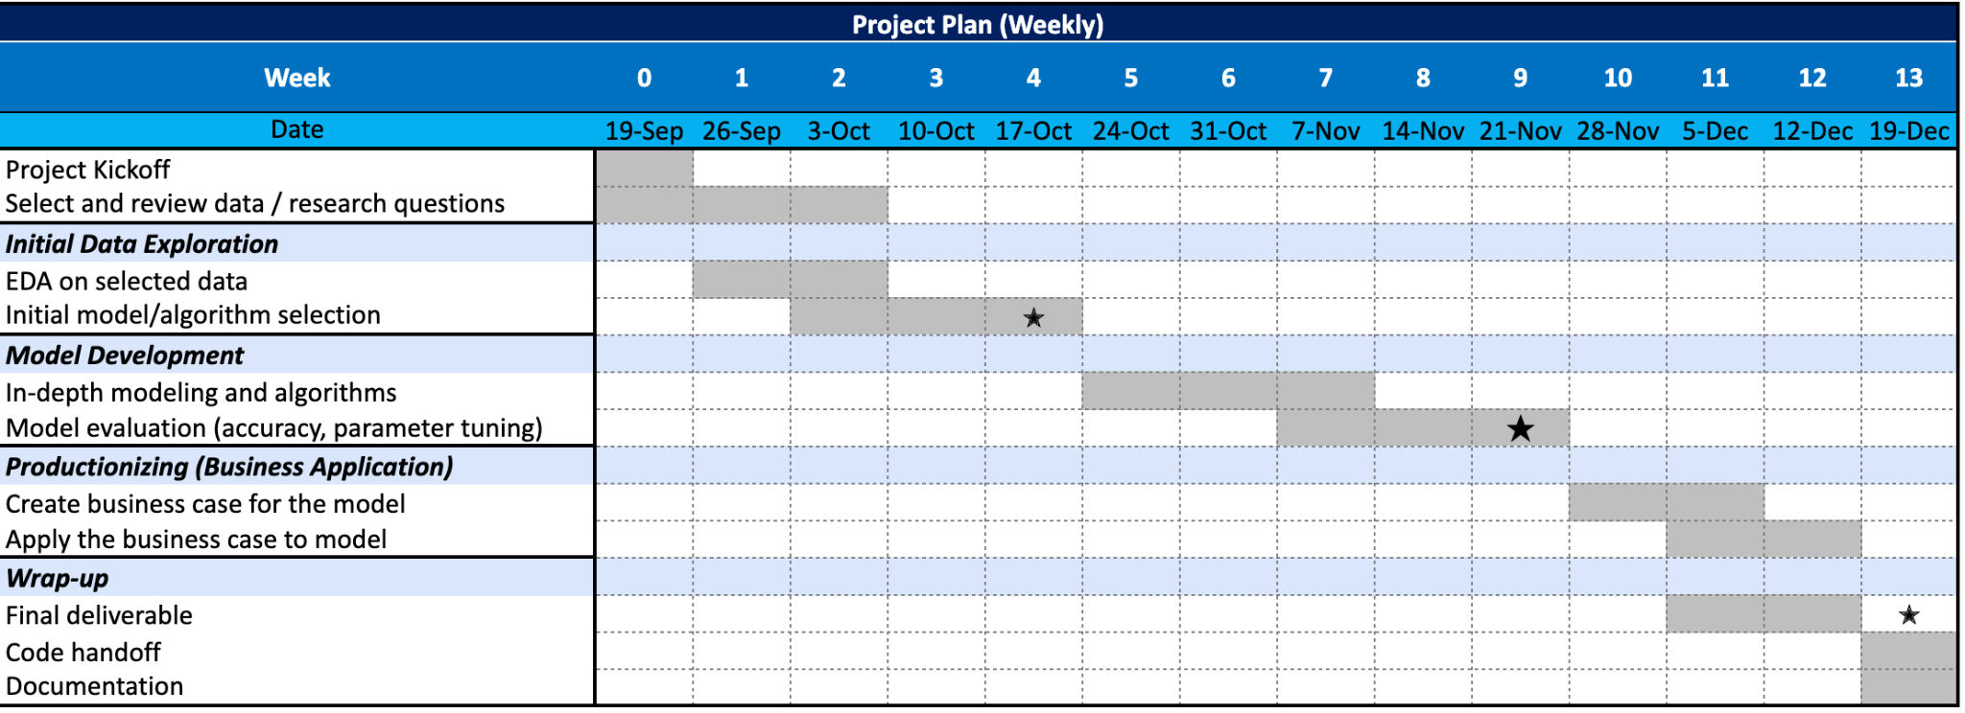
From Last Week: Timeline
1

Slide 6
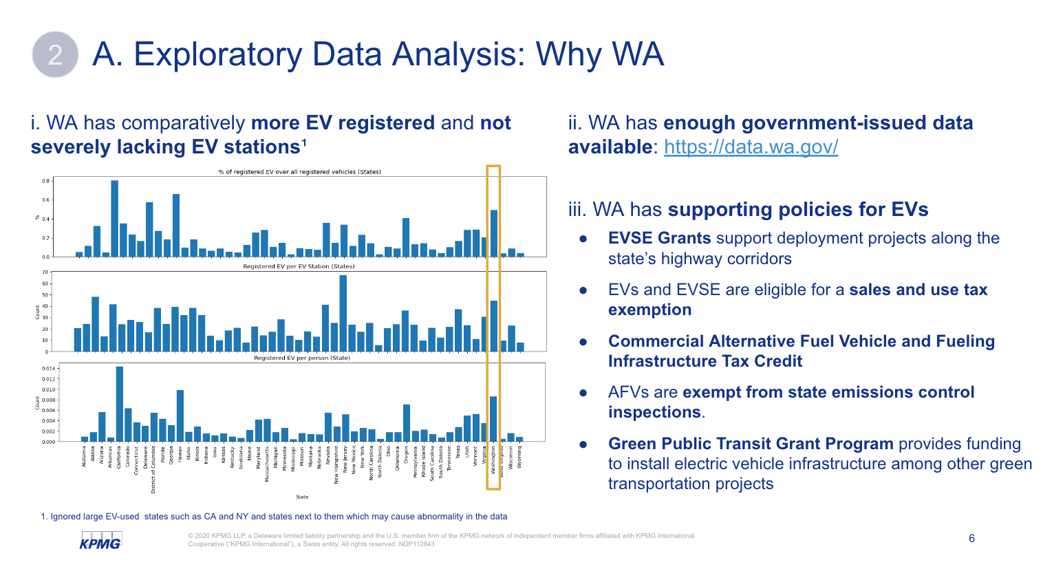
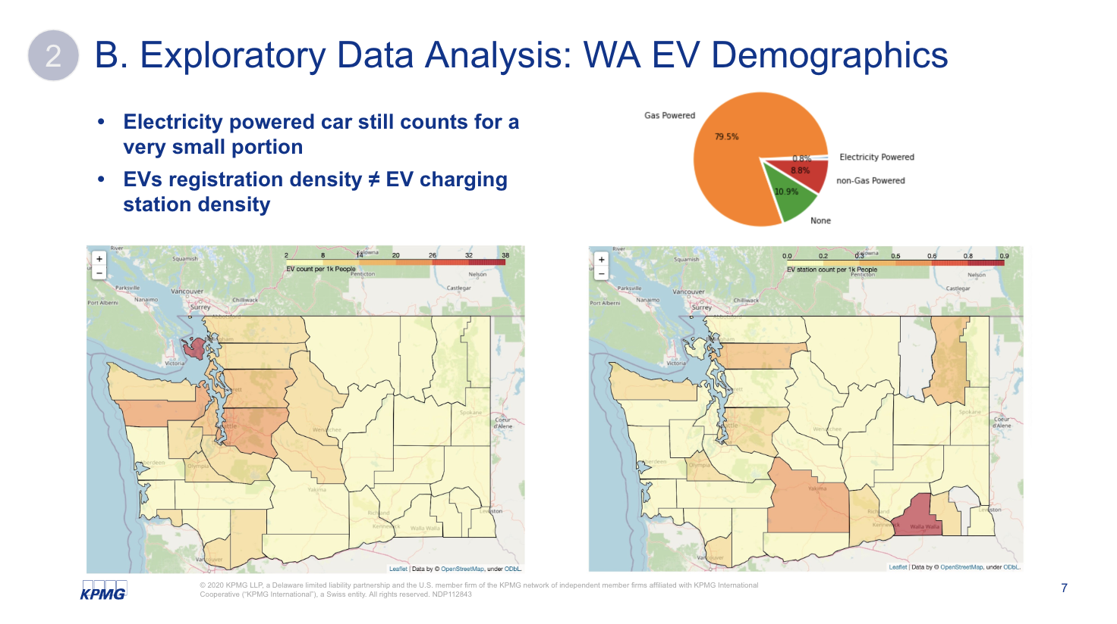
Research Question
2
What are the most important factors to consider when choosing EV charger locations in Washington state? Where are potential optimal locations?
A
Why WA
B
WA EV demographics

Slide 7
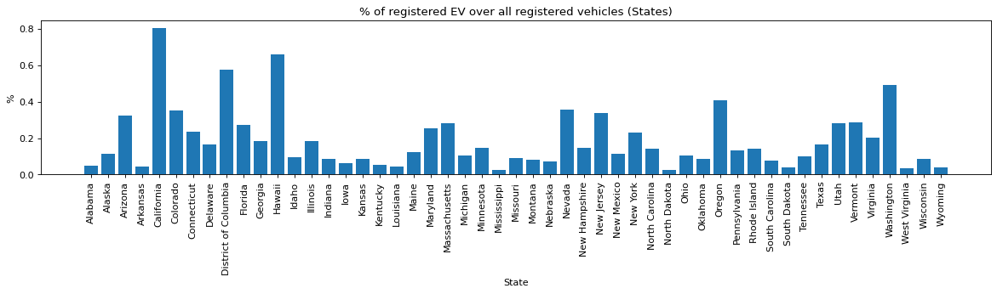
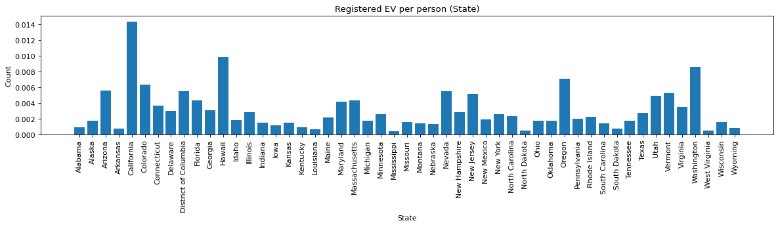
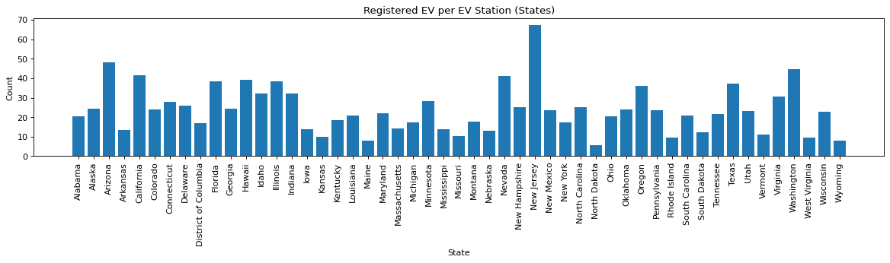
A. Exploratory Data Analysis: Why WA
2
i. WA has comparatively more EV registered and not severely lacking EV stations¹
ii. WA has enough government-issued data available: https://data.wa.gov/
iii. WA has supporting policies for EVs
EVSE Grants support deployment projects along the state’s highway corridors
EVs and EVSE are eligible for a sales and use tax exemption
Commercial Alternative Fuel Vehicle and Fueling Infrastructure Tax Credit
AFVs are exempt from state emissions control inspections.
Green Public Transit Grant Program provides funding to install EV infrastructure among other green transportation projects
1. Ignored large EV-used states such as CA and NY and states next to them which may cause abnormality in the data
Notes:
Distribution of

Slide 8
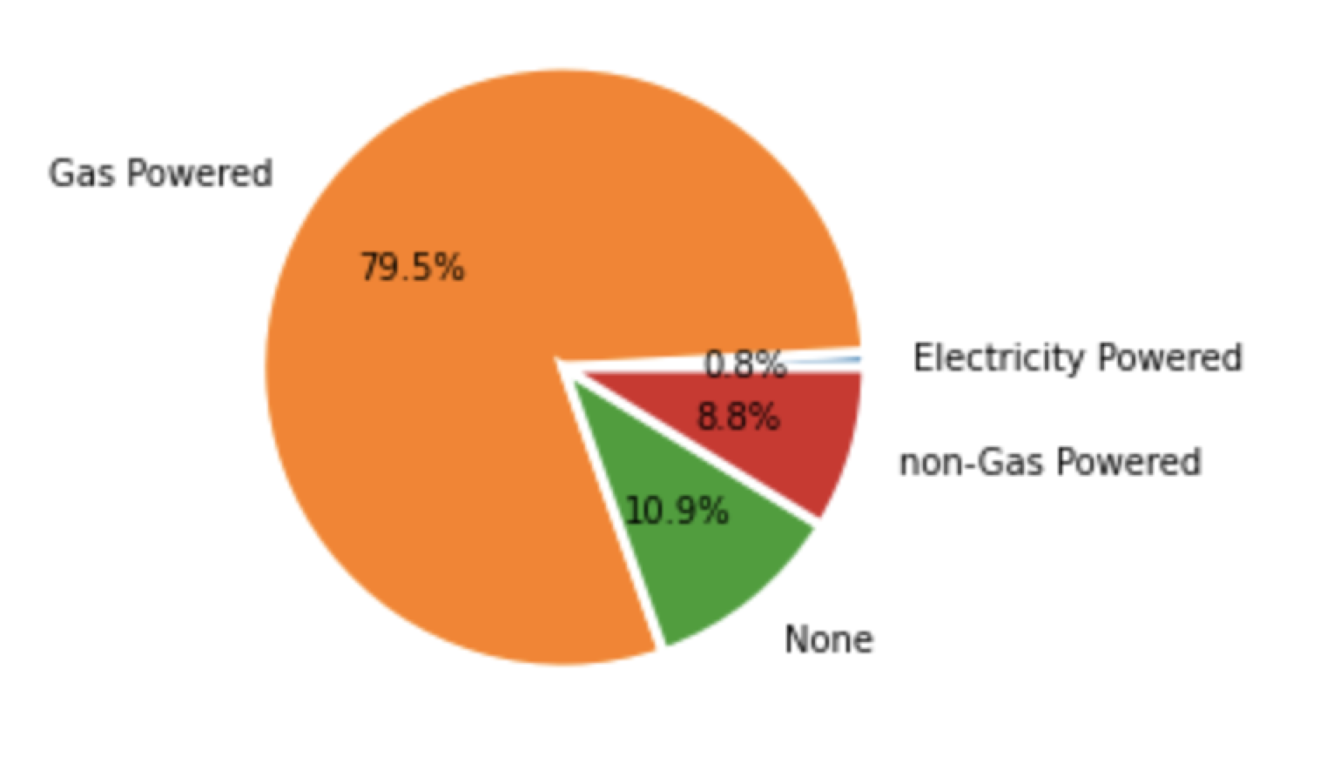
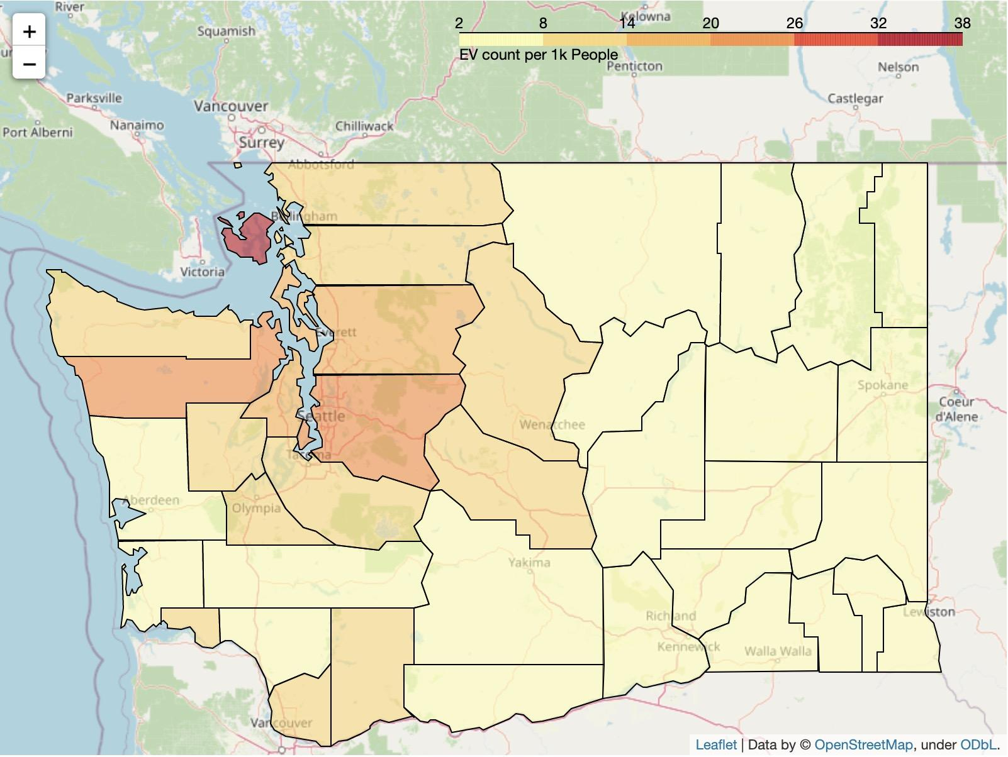
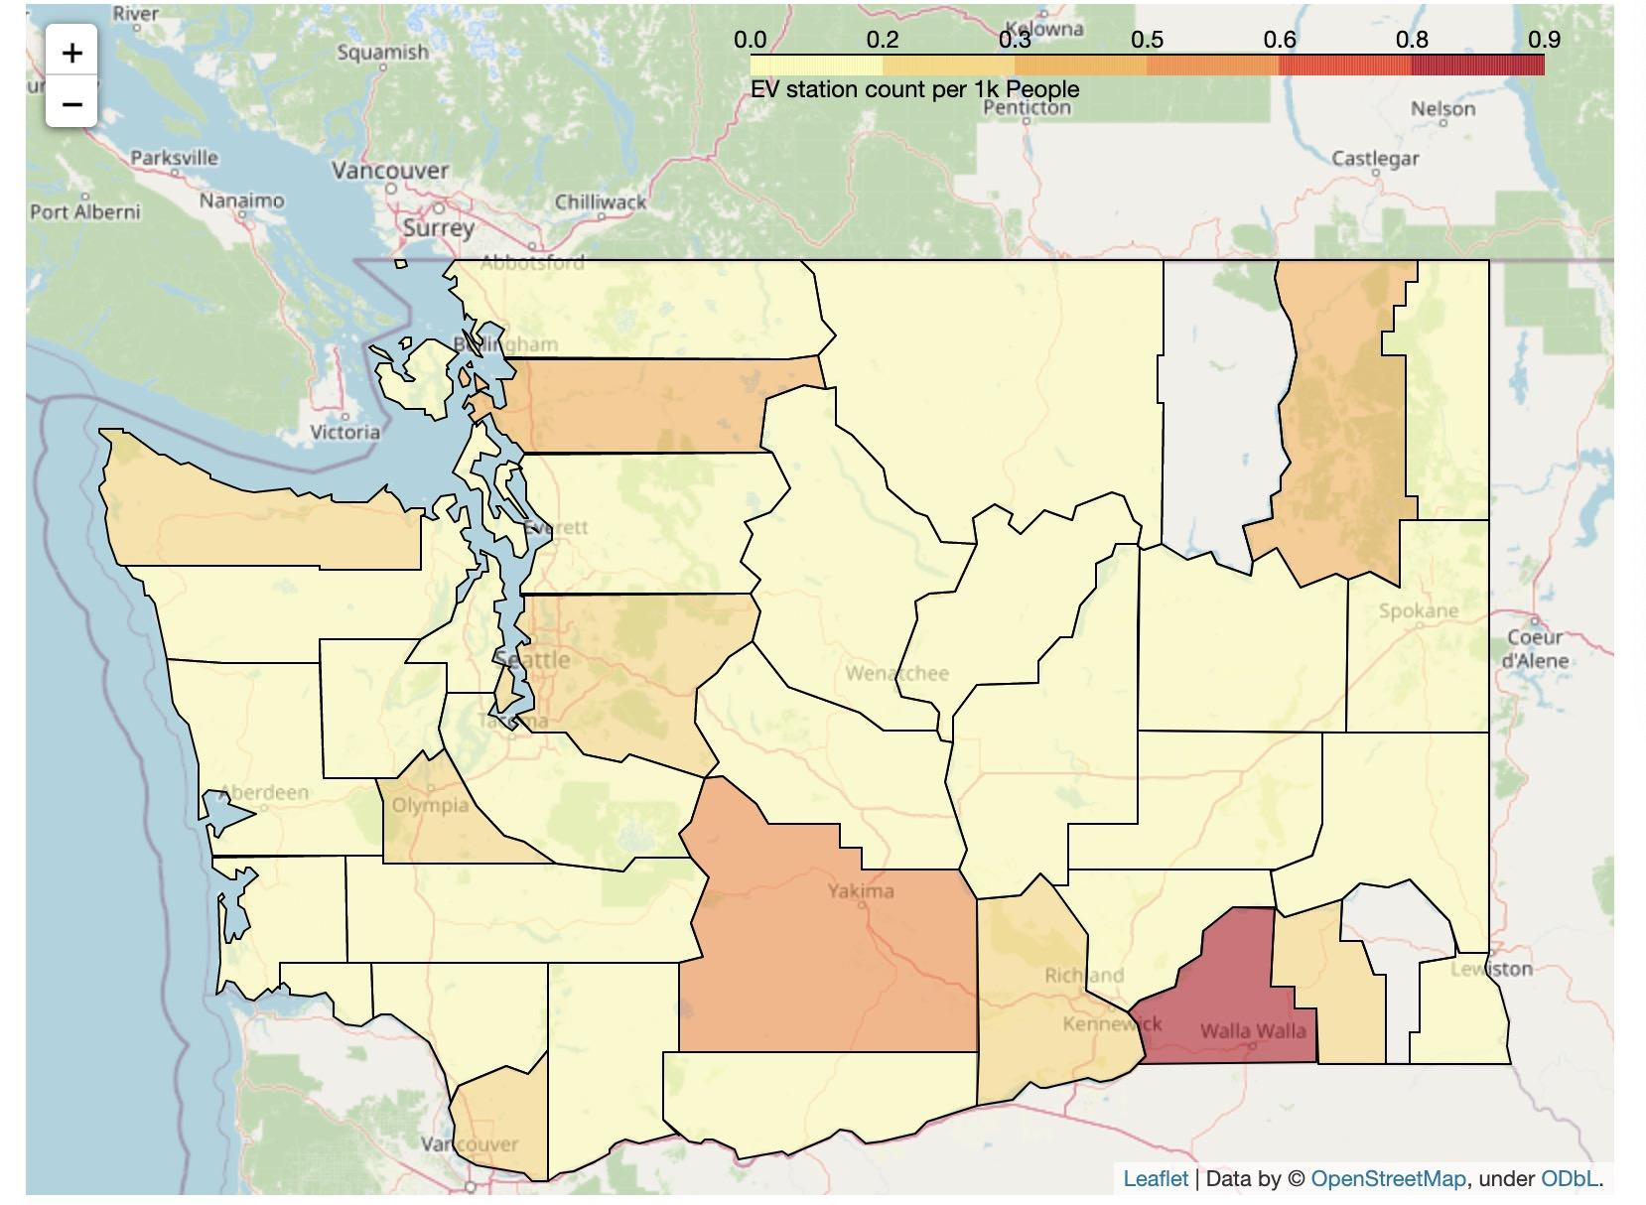
B. Exploratory Data Analysis: WA EV Demographics
2
Electricity powered car still counts for a very small portion
EVs registration density ≠ EV charging station density
Notes:
All light-duty vehicles sold, purchased, or registered in Washington state must be EVs by model year 2030.

Slide 9
Proposed Project Approach and Data Availability
3
Key Considerations
Distance
Constraints: distance between stations less than average EV est. range on a single charge
Approachability from highway / city centers (populations) / Electric Grids
Proposed Datasets
Population & demographic data:
American Community Survey (obtained)
OpenStreetMap data
Electric Grid map data
Gas station location data
EV charging station location data (obtained)
Charging Locations
Use gas station locations to simulate the location of EV charging stations
Renewable Energy
Evaluate the accessibility of renewable energy
Policy
Evaluate whether local policy supports for EV
Notes:
Add hypothesis: e.g. what factor will affect distance?
Which may or may not be feasible within this project - will there be sufficient electrical grid capacity for the newly proposed stations?
where would EV drivers want to "spend time" safety and security+ natural disaster
Potential Target audience
constraints

Slide 10
Next Steps
4
Action items:
Modify research question if necessary
Proceeds with EDA for selected dataset
Start searching for potential models/algorithms

Slide 11
Appendix

